Slide 1
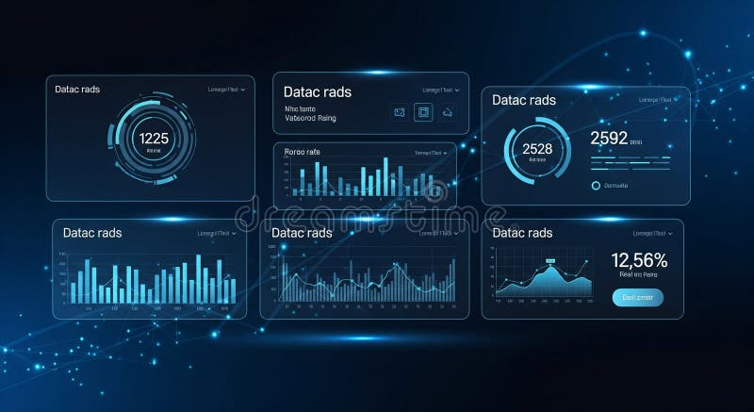
Group :3
Facebook Food Trends
Engagement Dashboard
Milestone 3 – Data Visualization using Power BI
This project analyzes Facebook engagement data related to different food categories, brands, post types, and posting times using Power BI dashboards.

Slide 2
Understanding the Data
Dataset Overview
The Facebook Food Trends Engagement Dataset captures comprehensive social media interaction data across food-related content. This dataset enables deep analysis of how audiences engage with different types of food posts on Facebook.
Project Goal
Engagement Metrics Analyzed
Metric
Metric
Identify patterns in audience interaction with food-related social media posts to understand what drives engagement and optimize content strategies.
Total Posts
Total Engagement
Metric
Metric
Likes
Comments
Metric
Shares

Slide 3
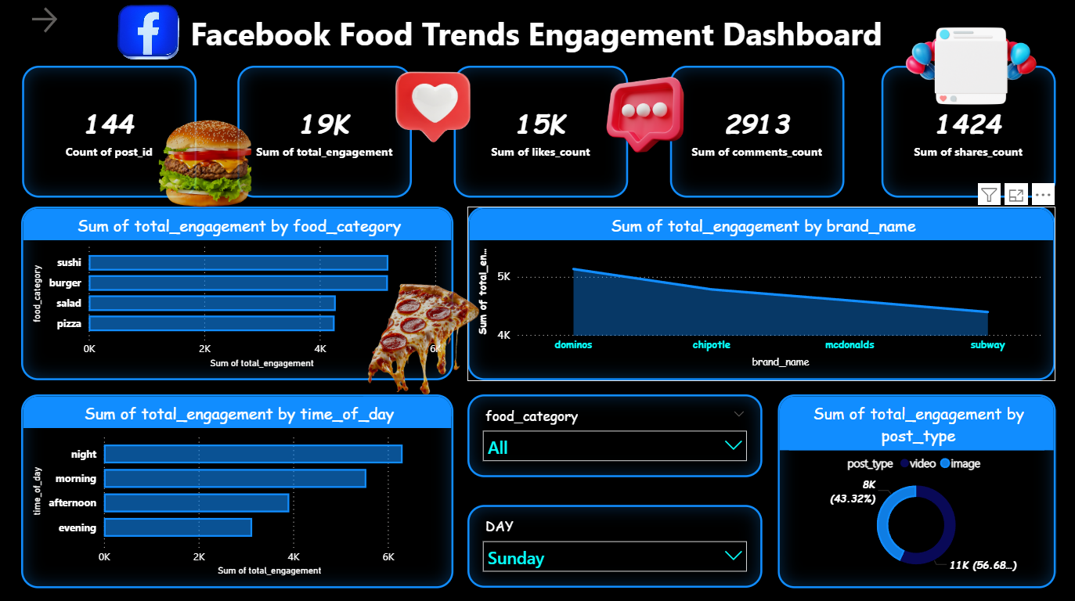
Interactive Analytics
Dashboard Overview
Power BI was used to create an interactive dashboard that summarizes key engagement metrics and trends. The dashboard provides real-time insights into audience behavior across multiple dimensions.
Insert Power BI Visual Here
Dashboard Overview Screenshot

Slide 4
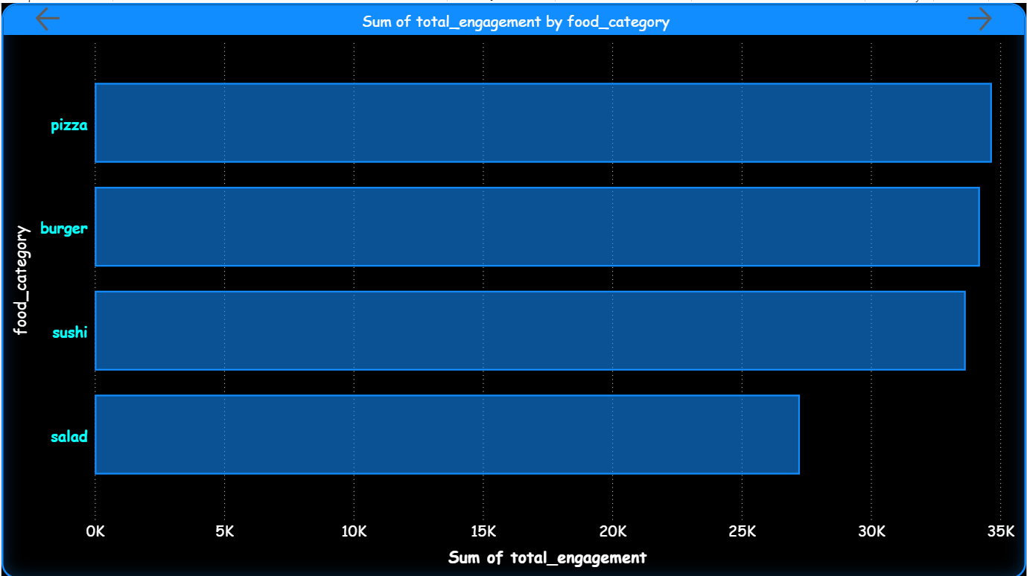
Category Analysis
Engagement by Food Category
Engagement was analyzed across different food categories including pizza, burger, sushi, and salad. Each category shows unique engagement patterns based on audience preferences.
Key Insight
Some categories generate significantly higher engagement than others
Insert Power BI Visual Here
Food Category Engagement Chart

Slide 5
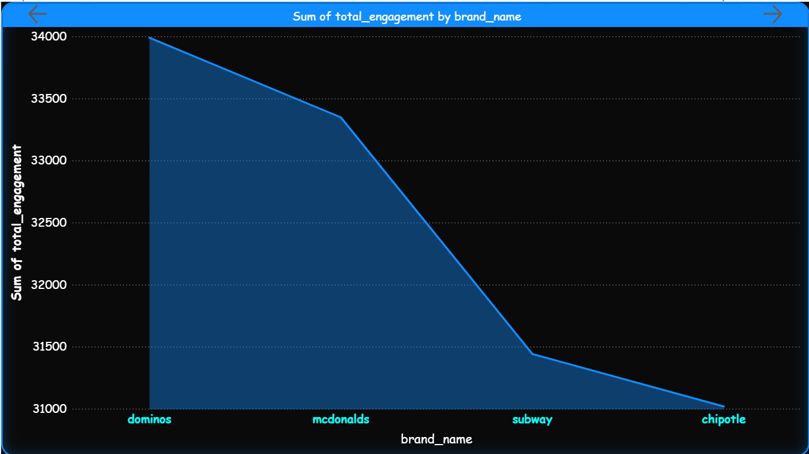
Brand Performance
Engagement by Brand
Engagement performance was analyzed for major food brands including Dominos, McDonalds, Subway, and Chipotle. Brand recognition and marketing strategies significantly impact audience interaction.
Key Insight
Certain brands attract higher audience interaction due to popularity and marketing
Insert Power BI Visual Here
Brand Engagement Chart

Slide 6
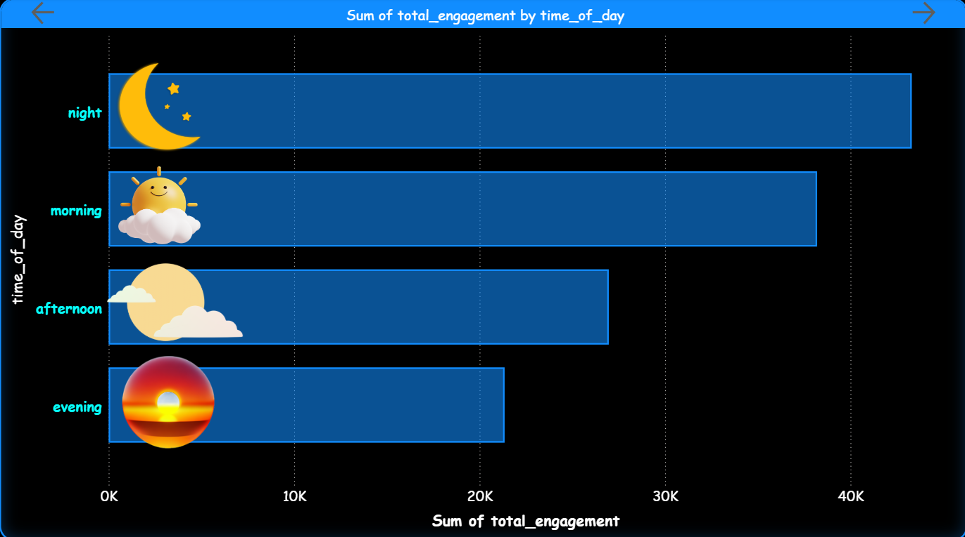
Temporal Analysis
Engagement by Time of Day
Posting time significantly affects engagement levels. Analysis covered four key time segments throughout the day.
Key Insight
Certain times of day produce higher engagement levels
Morning
Afternoon
Evening
Night
Insert Power BI Visual Here
Time of Day Engagement Chart

Slide 7
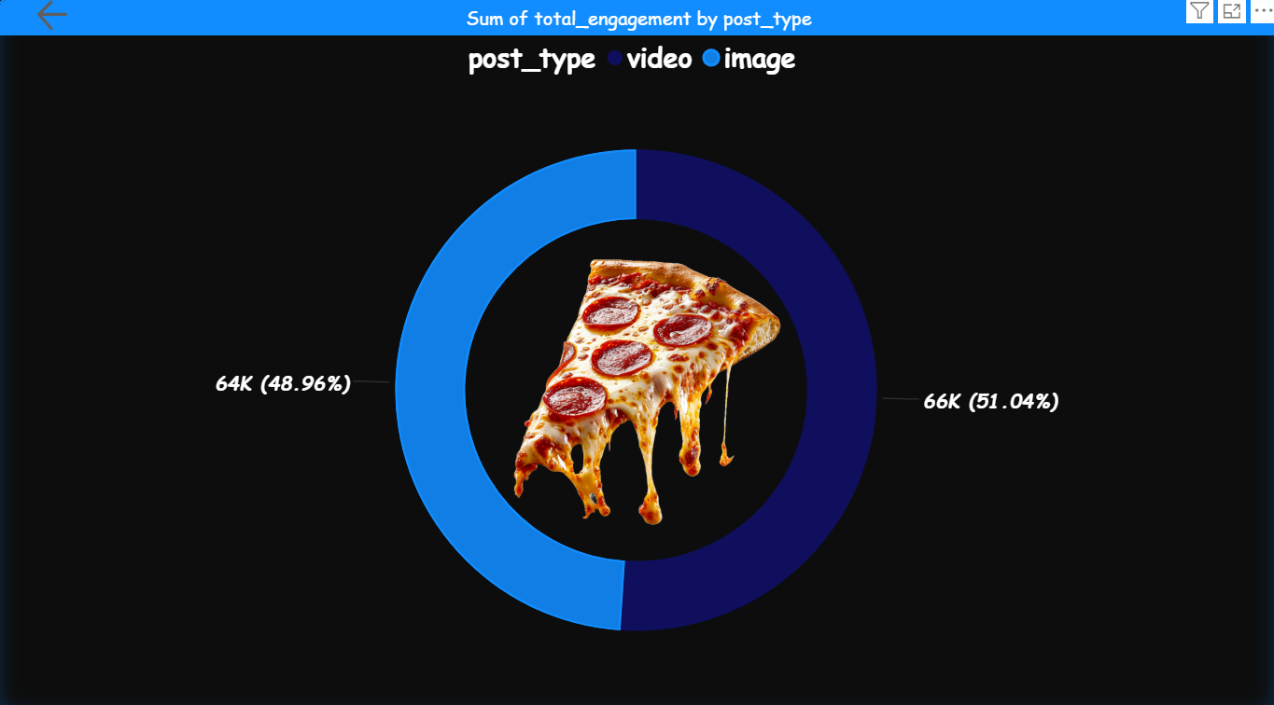
Content Format Analysis
Engagement by Post Type
A comparative analysis between image posts and video posts reveals how content format influences audience engagement and interaction patterns.
Key Insight
Video posts tend to generate slightly higher engagement than image posts
Insert Power BI Visual Here
Post Type Comparison Chart

Slide 8
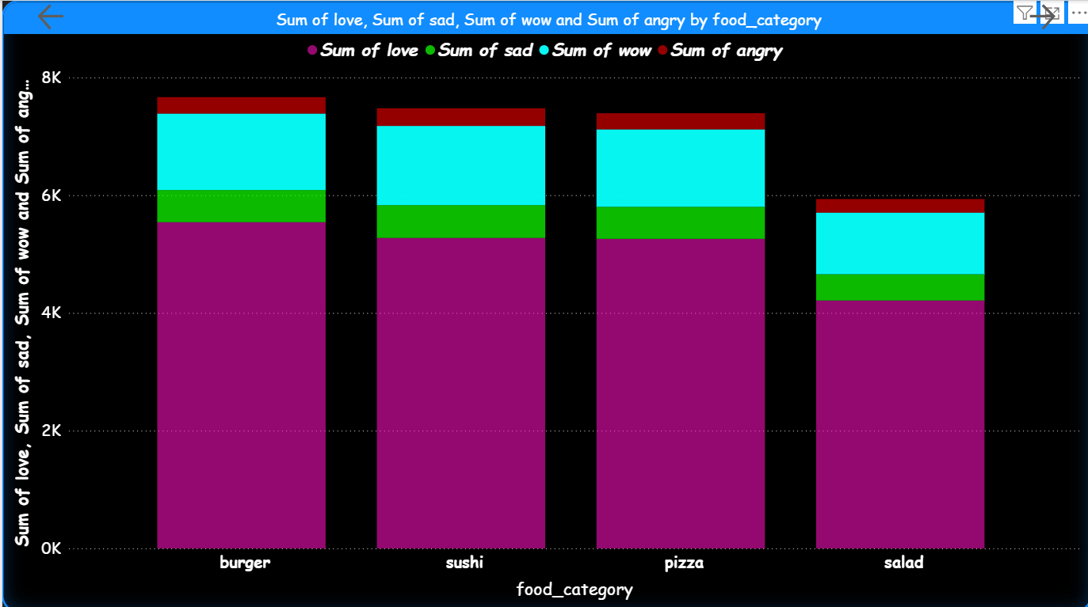
Sentiment Analysis
Reaction Analysis by Food Category
Analysis of Facebook reactions (love, wow, sad, angry) across food categories reveals sentiment patterns and audience emotional responses.
Key Insight
Positive reactions dominate engagement patterns
❤️
Love
😮
Wow
😢
Sad
😠
Angry
❤️
😢
Insert Power BI Visual Here
😠
Reaction Analysis Chart
😮

Slide 9
Summary of Findings
Key Insights
01
Food Category Impact
02
Brand Performance
Certain food categories receive significantly more engagement than others, indicating strong audience preferences for specific types of content.
Popular brands generate stronger audience interaction, demonstrating the importance of brand recognition and marketing effectiveness.
03
Optimal Posting Times
04
Video vs. Image
Posting time significantly affects engagement levels, with specific time windows showing higher audience activity and interaction rates.
Video posts perform slightly better than image posts, suggesting audiences prefer dynamic content formats for food-related posts.
05
Audience Sentiment
Most reactions are positive across all food categories, indicating that food content generally evokes favorable emotional responses from audiences.

Slide 10

Conclusion
Power BI visualization helps transform raw engagement data into meaningful insights that can support marketing decisions and content strategies.
Data-Driven Decisions
Strategic Insights
Optimized Content
Thank you for your attention

